Slide 1
Aspect-Based Sentiment Analysis with Python and spaCy
William Strausser, Data Analyst, Arts ISIT

Slide 2
Agenda
Sentiment analysis / aspect-based sentiment analysis overview
Implementation in Python with spaCy
Demo with real data in Tableau
UBC Faculty of Arts

Slide 3
Sentiment analysis
As defined by AWS, “sentiment analysis is the process of analyzing digital text to determine if the emotional tone of the message is positive, negative, or neutral.”
Analysis usually consists of passing text to a function which returns a “polarity” score between -1 and 1 (representing negativity and positivity, respectively).
For example:
“I love pizza.” = 0.6369
“I like pizza.” = 0.3612
“I don’t like pizza.” = -0.2755
Many different approaches can be used to conduct sentiment analysis, from simple ‘bag-of-words’ models utilizing lexical data compiled by hand, to sophisticated machine learning models trained on vast quantities of data.
UBC Faculty of Arts

Slide 4
Selecting a sentiment analysis model
For best performance, sentiment analysis models can be custom-trained from the data they will be used on. However, this process is quite time-consuming and requires advanced expertise.
Alternatively, there are several open source sentiment analysis models available requiring no custom training or other setup.
Our criteria for selecting a model:
Usable via a Python API
Fast, lightweight, and easy to install/use
Produces demonstrably meaningful data
UBC Faculty of Arts

Slide 5
Candidate models
TextBlob – Python package for performing a number of NLP tasks, including sentiment analysis.
Pattern – Another Python package with a variety of NLP and non-NLP tools, including sentiment analysis.
Valence Aware Dictionary and sEntiment Reasoner (VADER) – Long-standing pure sentiment analysis Python package specifically attuned to social media text data.
*Several other options exist on the market, but most rely on machine learning techniques and can be difficult to install/run based on hardware compatibility.
UBC Faculty of Arts

Slide 6
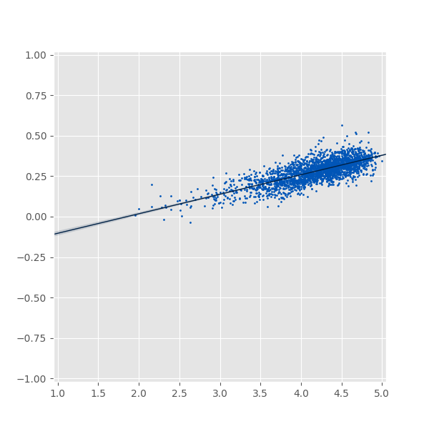

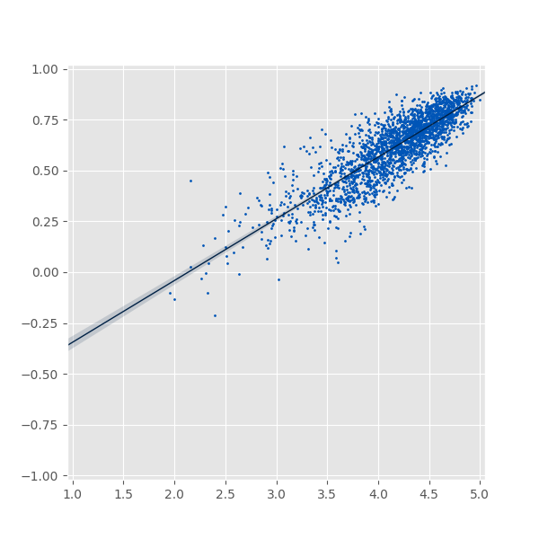
Model performance
x: Mean response to UMI 6 (“Overall, I learned a great deal from this instructor.”)
y: Mean sentiment score to open-ended question “Please comment on any aspects, positive or negative, of your instructor's teaching, attitudes to students, class atmosphere, or any other matters affecting the quality of instruction that you consider worthy of note.”
Each point represents one course taught in the Faculty of Arts from 2010-2022, excluding courses with fewer than 25 responses to either question.
TextBlob
Pattern
VADER
UBC Faculty of Arts

Slide 7
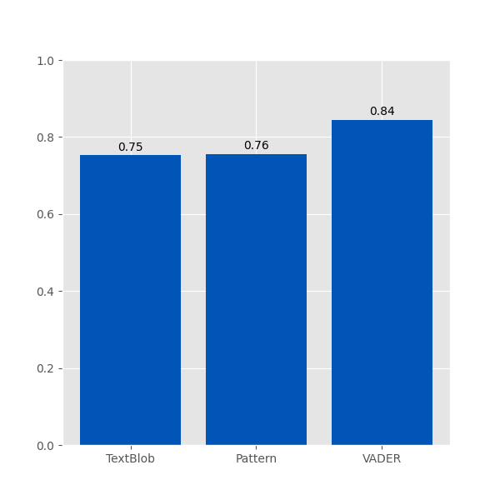
Model performance (cont.)
Calculating correlation coefficients of the previous slide’s data for each model yielded the following results:
UBC Faculty of Arts

Slide 8
Shortcomings of basic sentiment analysis
Semantic ambiguity: rule-based approaches, like the models introduced on the previous slides, often have difficulty with words that have multiple meanings.
E.g. the sentence “that person is mean” is evaluated by VADER as having a neutral sentiment score of 0, while this is clearly inaccurate to human eyes.
Complex sentiments: texts containing complex or multiple sentiments cannot be evaluated accurately.
E.g. the sentence “the food was good, but the service was bad” is clearly expressing two separate sentiments, but VADER evaluates this as having a purely negative sentiment of -0.5859.
The rest of the presentation will focus on addressing this problem.
UBC Faculty of Arts

Slide 9
Aspect-based sentiment analysis (ABSA)
Aspect-based sentiment analysis is a technique which aims to address the issue of complex sentiments mentioned in the previous slide.
This technique separates a text into distinct ‘aspects’ towards which sentiments are expressed, then assigns scores to each aspect, rather than the entire text.
UBC Faculty of Arts

Slide 10
The food was great, but the service was bad.
Conventional sentiment analysis: -0.5859
Aspect-based sentiment analysis:
Food: 0.4404
Service: -0.5423
UBC Faculty of Arts

Slide 11
What is spaCy?
“spaCy is a free, open-source library for advanced Natural Language Processing (NLP) in Python.
spaCy is designed specifically for production use and helps you build applications that process and ‘understand’ large volumes of text. It can be used to build information extraction or natural language understanding systems, or to pre-process text for deep learning.”
UBC Faculty of Arts

Slide 12
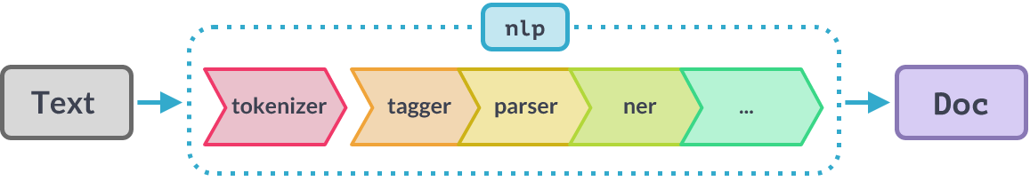
spaCy’s Processing Pipeline
UBC Faculty of Arts

Slide 13
Demo of spaCy and LA NLP
https://github.com/Arts-ISIT-LA/lava-2023-03/blob/main/lava_demo.ipynb
UBC Faculty of Arts

